Slide 1
Port Security
ITP|Institute of IT Professionals
Instructor:
Muhammad Naeem
(MSIT/RHCE/CCNP/CCNA/MCSE)
Cell: 0345-5238281
E-Mail: mna571@yahoo.com

Slide 2
Lecture Overview
Switch Port Security

Slide 3
Port Security
Secured ports restrict a port to a user-defined group of stations. When you assign secure addresses to a secure port, the switch does not forward any packets with source addresses outside the defined group of addresses. If you define the address table of a secure port to contain only one address, the workstation or server attached to that port is guaranteed the full bandwidth of the port. As part of securing the port, you can also define the size of the address table for the port.
Port security can only be configured on static access ports.

Slide 4
Port Security
Advantages of Port Security:
Dedicated bandwidth If the size of the address table is set to 1, the attached device is guaranteed the full bandwidth of the port.
Added security—Unknown devices cannot connect to the port

Slide 5
Port Security
COMMANDS TO VALIDATE PORT SECURITY:
Interface :Port to secure.
Security :Enable port security on the port.
Trap :Issue a trap when an address-security violation occurs.
Shutdown Port :Disable the port when an address-security violation occurs.

Slide 6
Port Security
Secure Addresses :Number of addresses in the secure address table for this port. Secure ports have at least one address.
Max Addresses :Number of addresses that the secure address table for the port can contain.
Security Rejects :Number of unauthorized addresses seen on the port.

Slide 7
Port Security
Security Violation Mode:
Shutdown- The interface is shut down immediately following a security violation
Restrict- A security violation sends a trap to the network management station.
Protect- When the port secure addresses reach the allowed limit on the port, all packets with unknown addresses are dropped.
**The default is shutdown

Slide 8
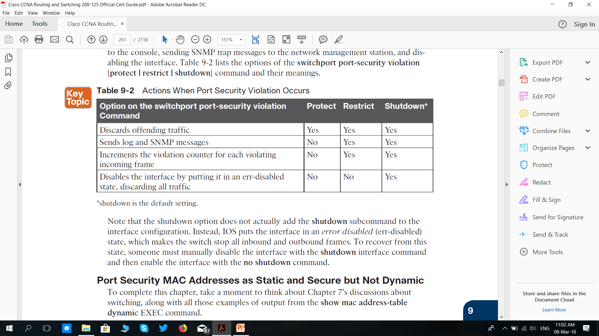
Security Violation Mode:

Slide 9
Port Security
Defining the Maximum Secure Address Count:
A secure port can have from 1 to 132 associated secure addresses. Setting one address in the MAC address table for the port ensures that the attached device has the full bandwidth of the port. If the secure-port maximum addresses are set between 1 to 132 addresses and some of the secure addresses have not been added by user, the remaining addresses are dynamically learnt and become secure addresses.

Slide 10
Port Security
Enabling Port Security on The Switch:
Beginning in privileged EXEC mode on the switch, follow these steps to enable port security, these settings will guarantee accurate and tight security.

Slide 11
Port Security Table of Commands

Slide 12
Port Security Table of Commands

Slide 13
DISABLING PORT SECURITY

Slide 14
Commands
Switch#conf terminal
Switch(conf)# int fa0/1
Switch(conf-if)# switchport mode access
Switch(conf-if)# switchport port-security
Switch(conf-if)# switchport port-security maximum 1
Switch(conf-if)# switchport port-security mac-add xx.xx.xxx
Switch(conf-if)# switchport port-security violation shutdown
Switch(conf-if)# spanning-tree portfast

Slide 15
Commands
Show commands;
Switch# sh port-security
Switch# sh port-security int fa0/1
Switch# sh ip int brief

